Slide 1
Battle of Neighborhoods Manhattan, NY
Analyze best neighborhoods for setting up a new Indian Restaurant

Slide 2
Use the NY Neighborhood data
Download the json file with NY neighborhood data from a previous exercise
Exclude all except Manhattan Borough
Call Foursquare API for getting near by venues per Manhattan neighborhoods
Create a separate Data frame for storing neighborhoods with existing Indian places
Also make a data frame to store and later analyze all the near by venues per neighborhood. This would be used along with Indian places data frame to narrow down on neighborhood selection

Slide 3
Explore Manhattan neighborhoods
Analyze the neighborhoods which already have popular Indian joints like Movie Theatre, Yoga centers etc.
Note down the other prominent Manhattan neighborhoods which don’t have an Indian Restaurant in the proximity
using Foursquare nearby venue details, check if these neighborhoods are appropriate for eateries (what’s surrounding, other restaurants, bars, parks etc.)
Create a cluster of Manhattan neighborhoods to understand there coordinates, similarities etc.
Finally use these data points to narrow down on the neighborhood of choice

Slide 4
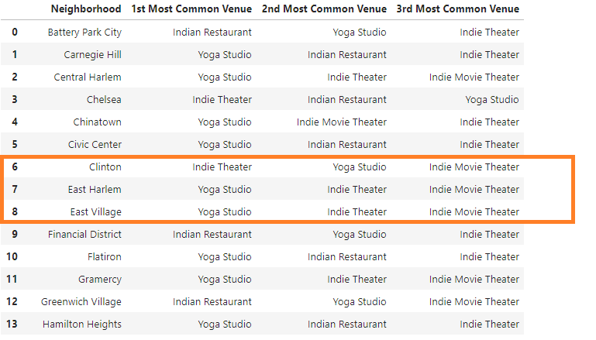
Sample: Indian places in Manhattan Neighborhoods
For illustration purpose only, please refer to coding module for details

Slide 5
Recommendations & Conclusion
I would recommend the neighbourhoods of “Clinton”, “East Harlem”, “Upper East Side”, ”Financial District”, “Inwood”, “Lenox Hill”, “Lincon square”, “Upper East Side”, “West Village” for setting up the new restaurant. The reason being they have Yoga centres, Indian or other Theatres around and would be most appropriate to setup a new Indian Restaurant. These neighbourhoods are also prominent places for other eateries, bars, gyms, parks etc.
Conclusion: This analysis is very helpful to decide on the best neighbourhoods in Manhattan to setup a new Indian Restaurant. It provides option by laying down the important data points for sound decision making. I however haven’t consider the rent and availability of places in deciding the neighbourhood mainly because those two factors though very important are volatile and may change from one point in to other. If someone is interested to use my work and want to factor in other elements, I am happy to take into consideration the same and expand the analysis accordingly.

